Slide 1
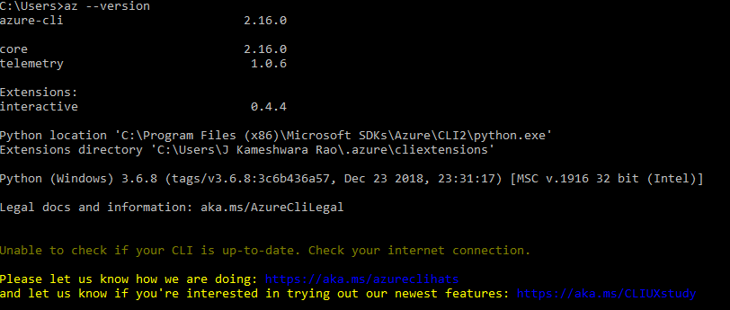
Automation with Azure CLI Installation
Azure CLI Insallation
1. Install Microsoft Azure CLI
https://docs.microsoft.com/en-us/cli/azure/install-azure-cli-windows?tabs=azure-cli
2. Open command prompt run : az --version
Azure CLI commands
az login
az account
az group
az group list
az group create
az storage create
az vm create
az logout

Slide 2
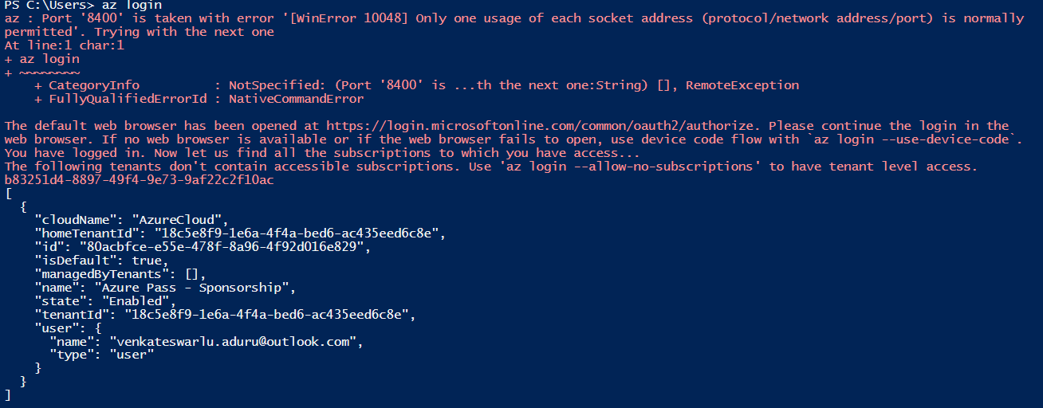
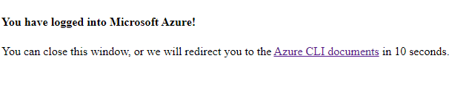
Automation with Azure CLI – Login
Azure Login
1. Open Powershell ISE / VS
2. Login to azure by running in PS ISE terminal : az login

Slide 3
Create Resource group
Step1. Login to Azure account by running az login in Powershel ISE/ VSC
Step 2. Create a resource group powershell script run the script PS > group create --name AkmetRG --location 'centralus'
Step 3. create virtual Machine by running command PS > : az>> vm create --name VM3 --resource-group AkmetRG --image Win2016Datacenter --admin-username sadmin --admin-password India@123456 --vnet-name VNet3 --subnet subnet3
Step 4. Login to portal and check the details of virtual machine and login using RDP
Step 4. Cleanup resources resource Group
Step 6 . Logout from Az logout

Slide 4
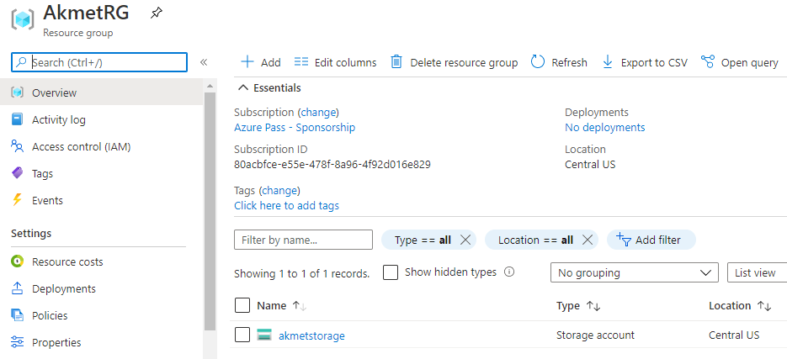
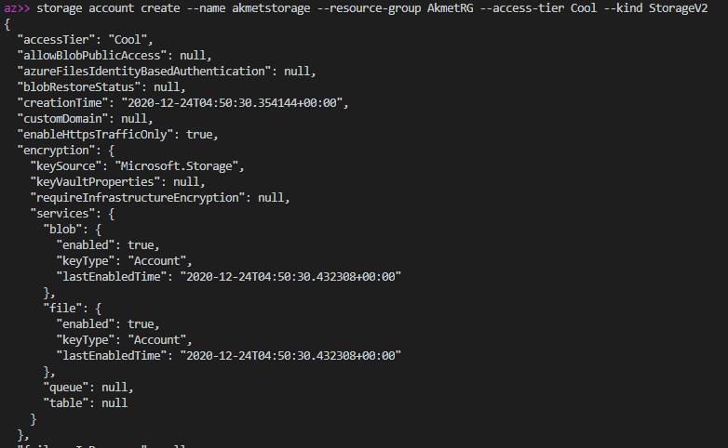
Create Storage account
Step1. Login to Azure account by running az login in Powershel ISE/ VSC
Step 2. Create a resource group powershell script run the below script
az>> storage account create --name akmetstorage --resource-group AkmetRG --access-tier Cool --kind StorageV2
Step 3. List storge account by running PS > : az>> storage account list --resource-group AkmetRG --output table
Step 4. Login to portal and check the details Storage account
Step 5 . Cleanup resources Storage.

Slide 5
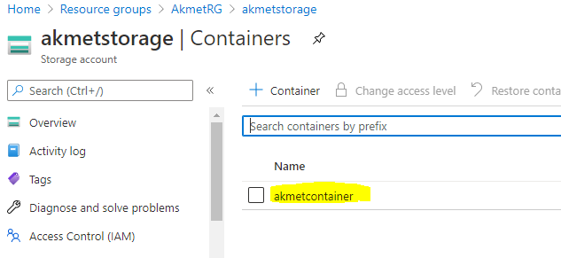
Create Storage account container
Step1. Login to Azure account by running az login in Powershel ISE/ VSC
Step 2. Create a resource group powershell script and run the below script for reference
az>> storage account create --name akmetstorage --resource-group AkmetRG --access-tier Cool --kind StorageV2
Step 3. Creating a storage container run below powershell PS > storage container create --account-name akmetstorage --name AkmetContainer --account-key 'PxKZ+H/V/SSWQ4ZZjugWg5FJfpQT6p5mjjrge7ipI5zDayfAYoQSbnGrQ2DxPkwNSCkII8WbCBlgbl5jRZFvqw==' --resource-group AkmetRG
Step 4. Login to portal and check the details Storage account container
Step 5 . Cleanup resources Storage.

Slide 6
Azure CLI - Virtual Machine
Step1. Login to Azure account
Step 2. Create a Virtual machine powershell script
vm create --name akmetvm -g myresourcegroup1 -l centralus --admin-username sadmin --admin-password Venkat1234567 --image Win2012Datacenter
Step 3. Login to portal and check the details
Step 4. delete Virtual Machine
Step 5 . Logout from Az logout
Step 6 Vnet
vnet create --name AkmetVNet--resource-group RG

